Slide 1

A ‘Swiss Army Knife’ for SAS Data Analysis
WojCIECH Potrzebowski

Slide 2


User Journey
Data reduction
Experiment control
Data streaming
Data analysis
User Office Software
Before experiment
During experiment
During and after experiment

Slide 3
Typical SasView workflow
For reduced data:
Load and plot experimental data
Define a model (form and structure factor) with parameters
Fit the parameters so that model matches experimental data
Draw scientific conclusions and publish results!

Slide 4
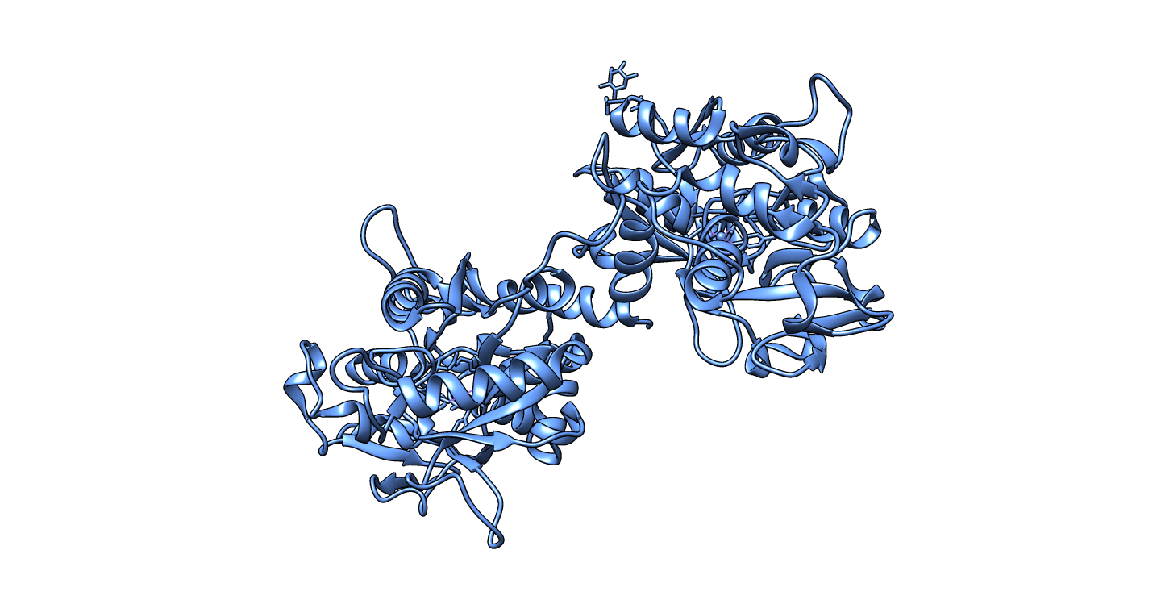
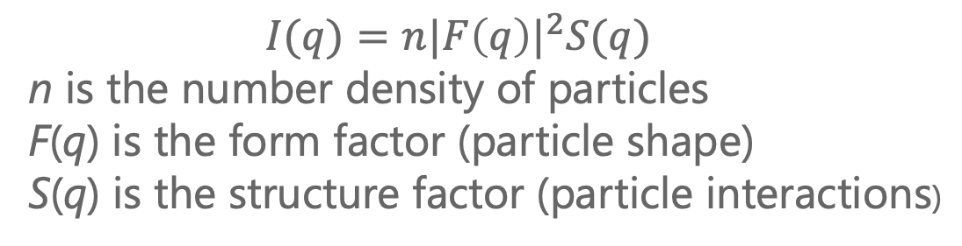
Defining model is crucial for data analysis
$$I(q)=n{|F\left(q\right)|}^{2}S(q)$$
n is the number density of particles
F(q) is the form factor (particle shape)
S(q) is the structure factor (particle interactions)
Protein structure coordinates
Cylinder radius = 40Å, lenght = 200Å
Hardsphere, effective radius = 50Å

Slide 5
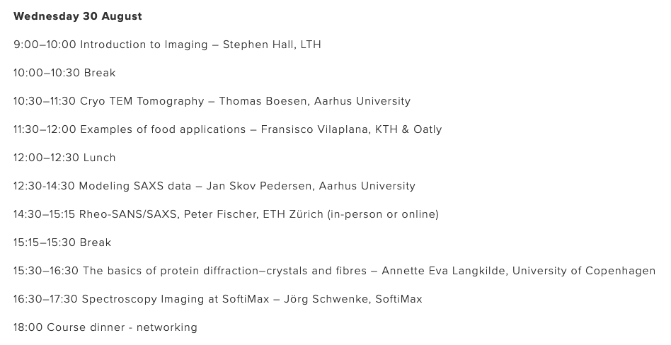
Form and structure factors
Proper lecture tomorrow

Slide 6
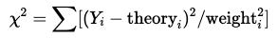
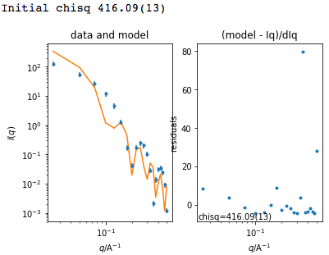
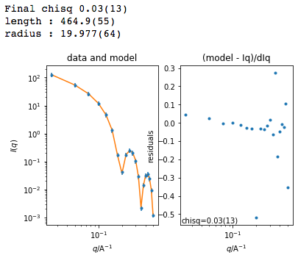
Fitting model to data is typically done through χ² optimization
 | Before fit
model
lenght | 350 Å
radius | 35 Å
 | 416.9
After fit
400 Å
40 Å
0.03

Slide 7
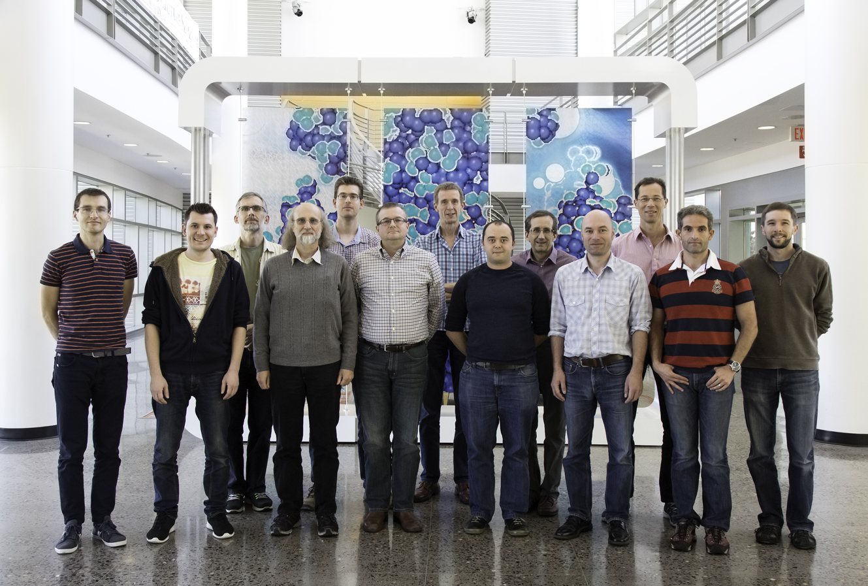
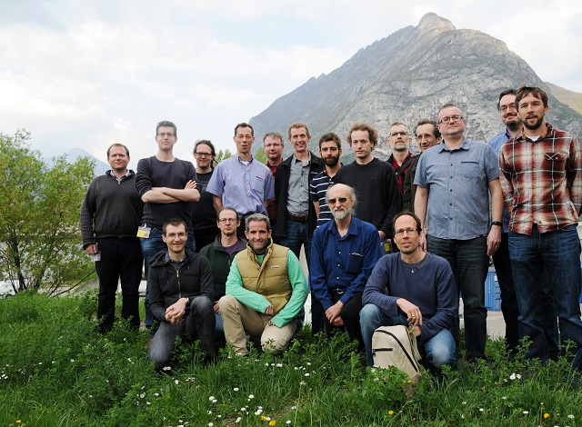
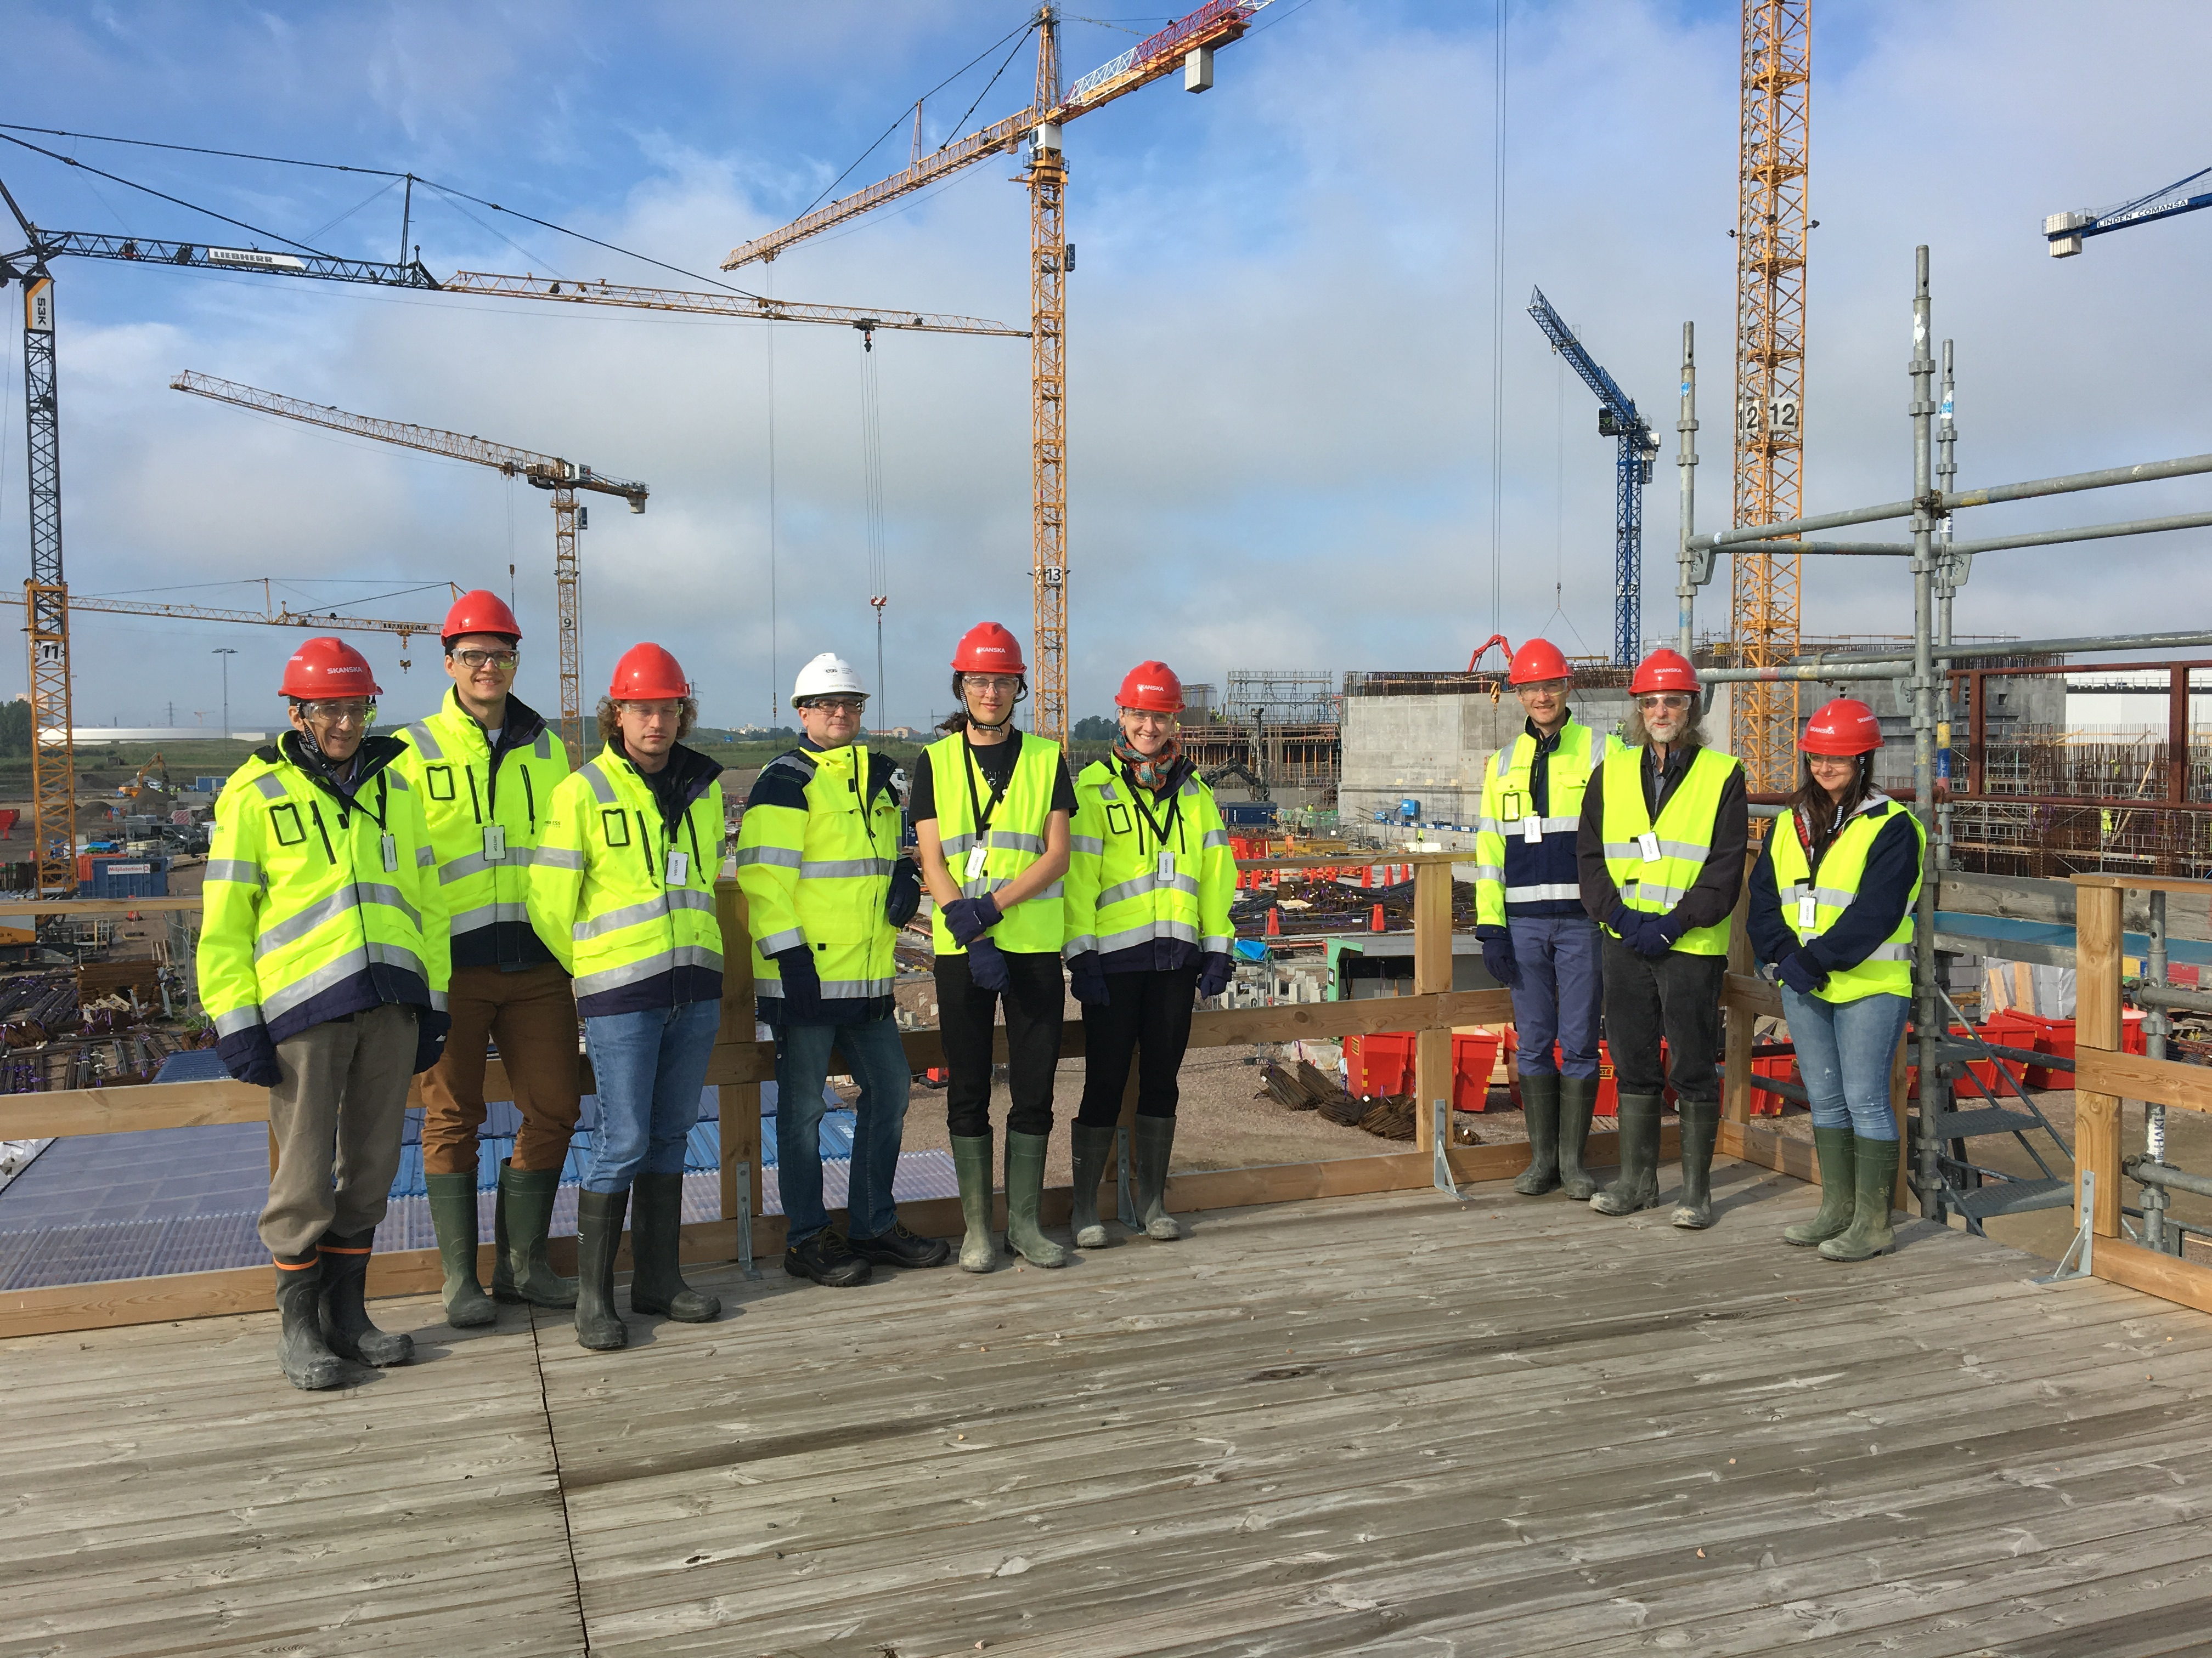
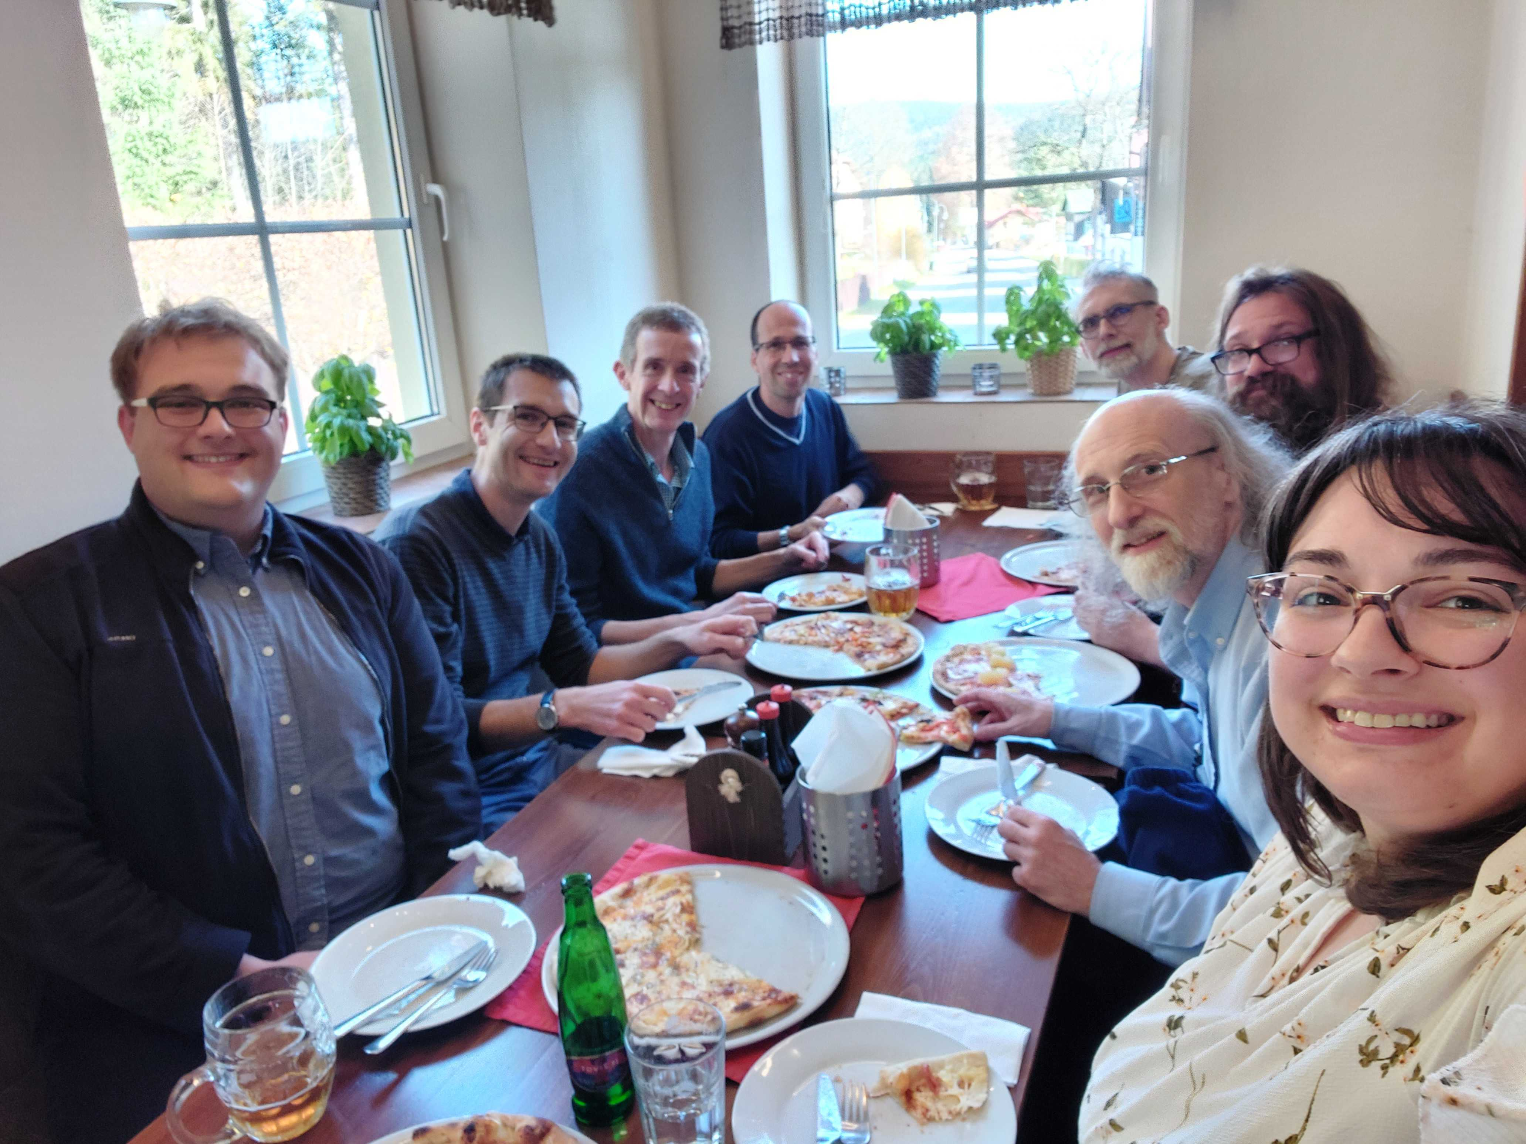
The SasView approach
An open, collaborative, community development
Community driven project
Supported by 9 facilities, 40 contributors (~15 active at any one time)
Small leadership team: Paul Butler (NIST), Steve King (ISIS), Wojciech Potrzebowski (ESS)
Biweekly calls
Regular SasView camps and hackathons
Hosted on github: https://github.com/SasView/sasview
Pictures from Code Camps: V, VI, VIII, X
www.sasview.org

Slide 8
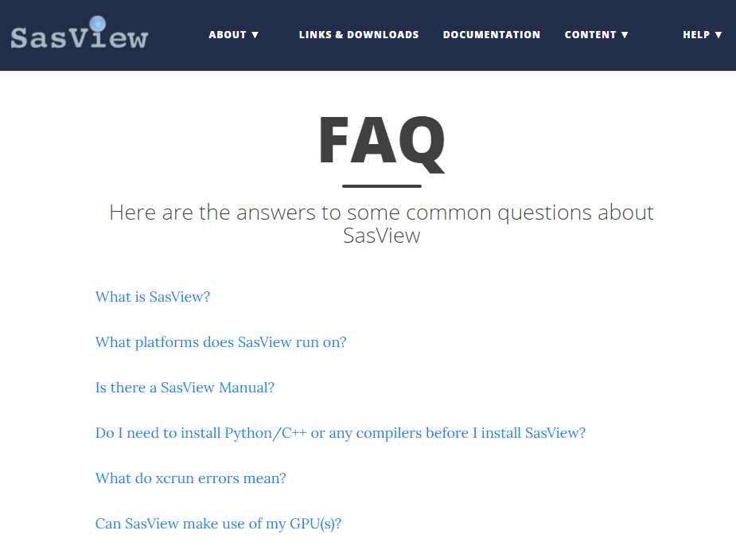
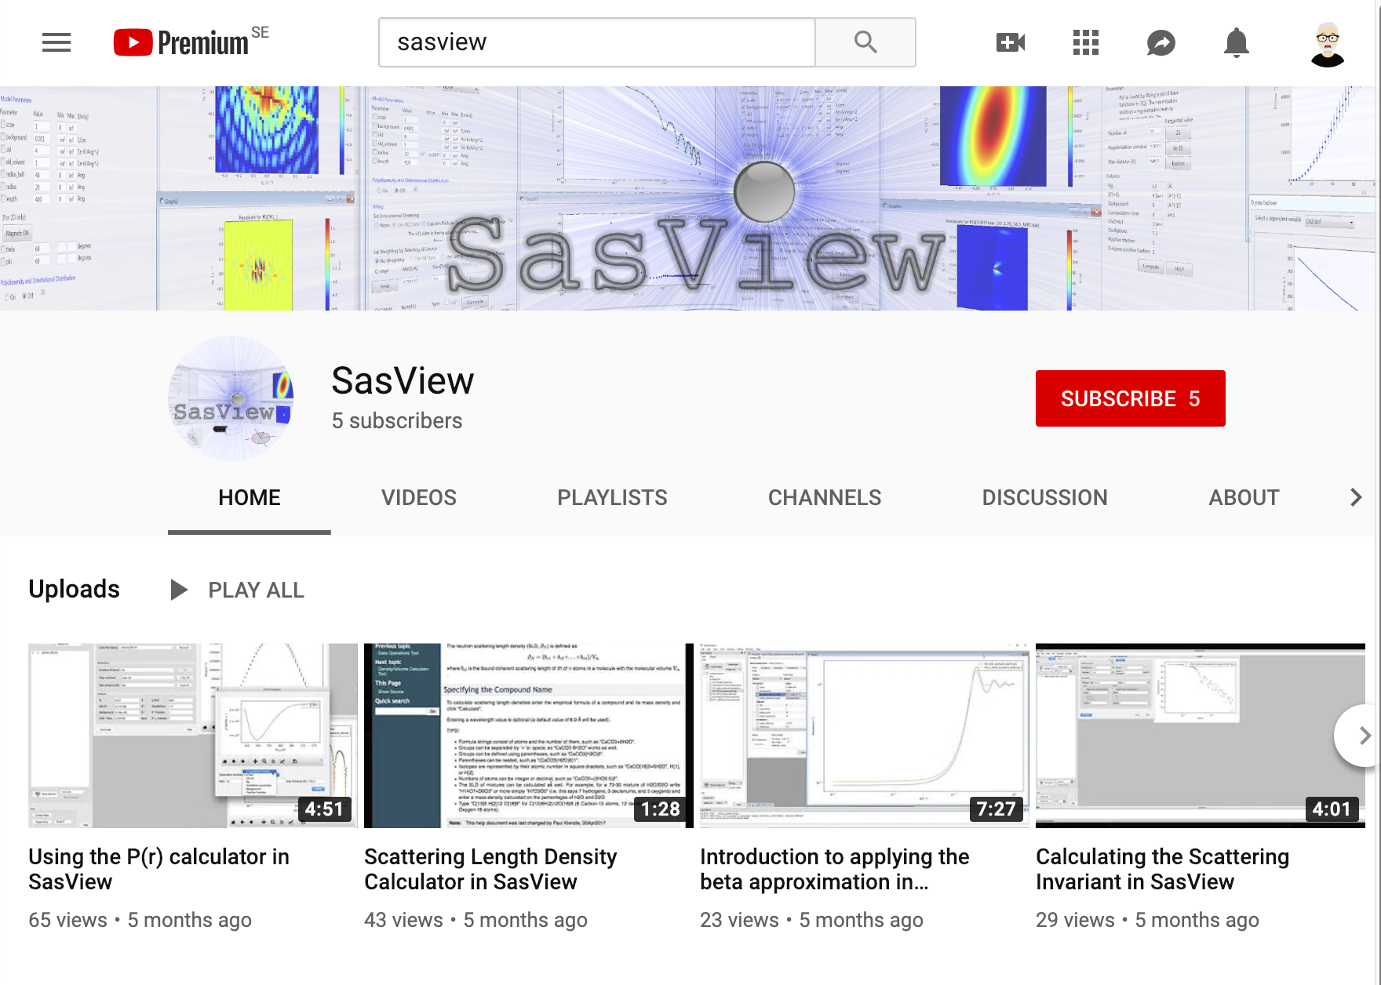
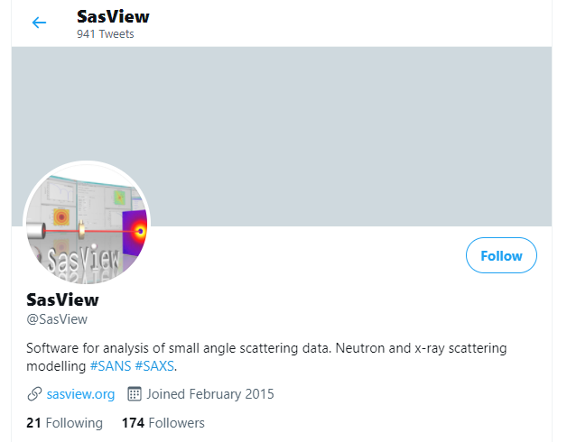
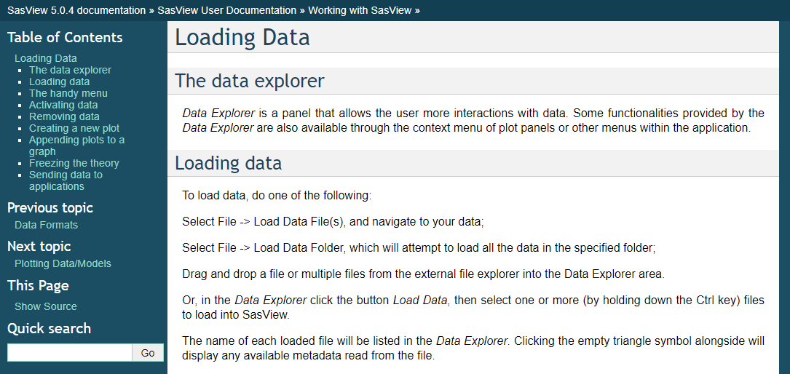
User support
Documentation and communication channels
Website
Documentation
in-program & online
Written Tutorials
Video Tutorials (YouTube)
Taught Courses
scattering schools/workshops
university courses
Bootcamps & regional workshops
e-Learning
Slack
Twitter
(Marketplace)
help@sasview.org
users@sasview.org

Slide 9
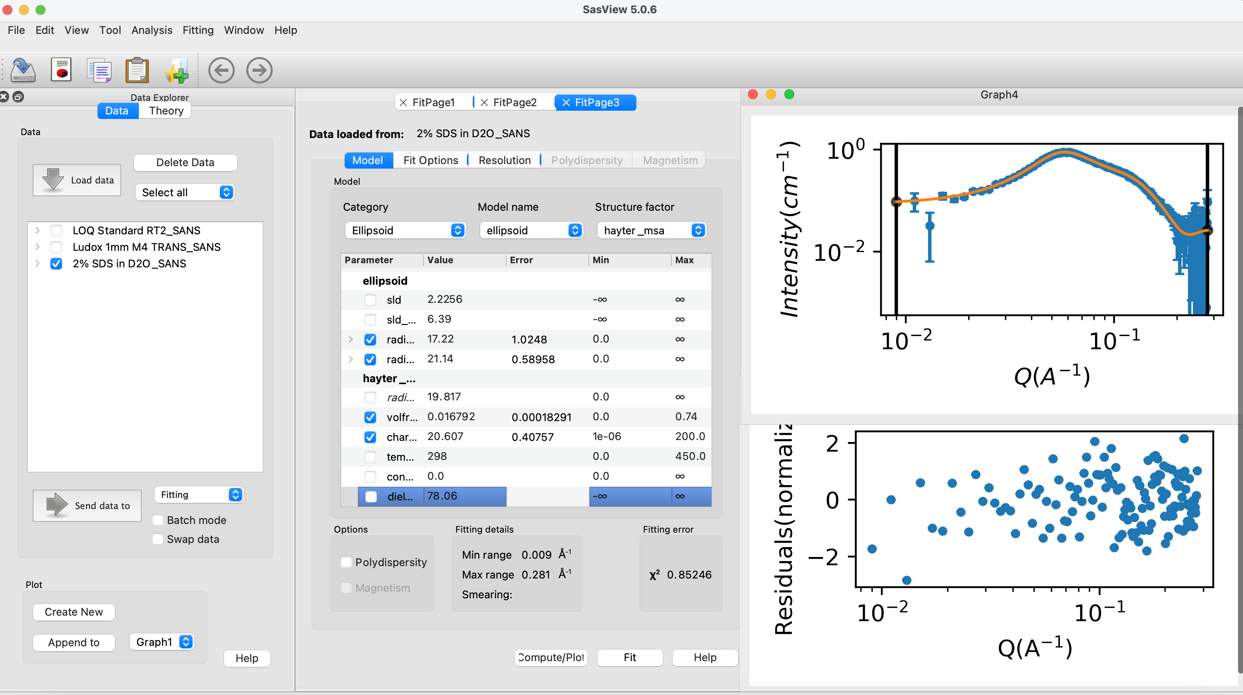
Fitting in SasView
70+ models to explain data
Wide choice of built-in models (> 70)
F(Q), S(Q) & F(Q)*S(Q)
Single, batch and simultaneous fitting
Data management
Common data formats supported, including NXCansas & cansas1D
Analysis Tool Choice
&
Plotting
Polydispersity (choice of distribution and distribution parameters)
Resolution smearing (pinhole and slit)
Automatically from data or provide parameters

Slide 10
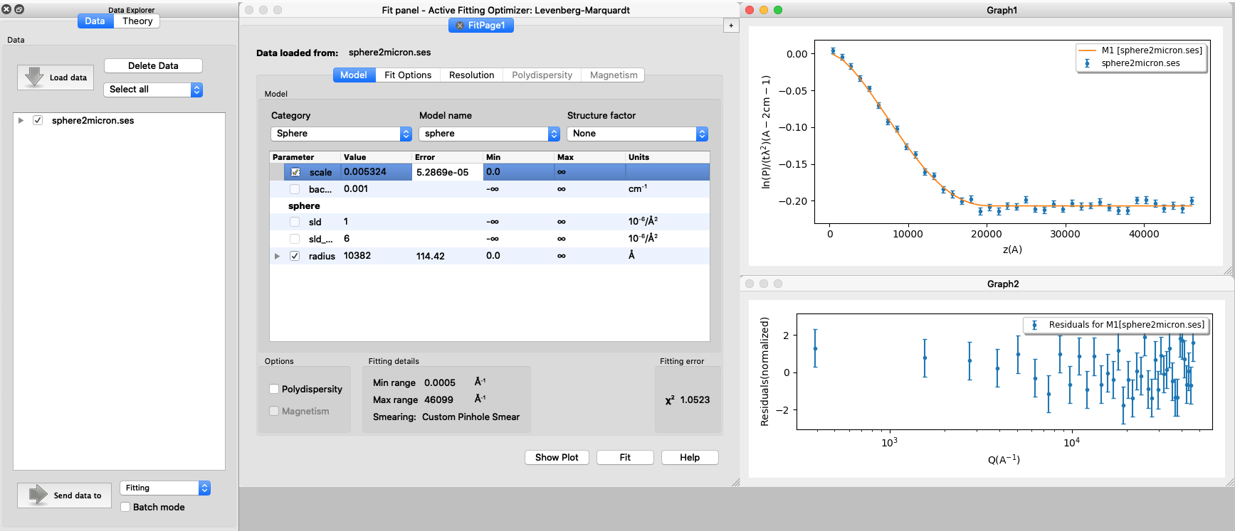
SESANS data
SasView provides functionality for analysing SESANS data
SasView recognizes SESANS data and starts specific workflow
Automatic Hankel Transform of SANS models
Access to all SasView models

Slide 11
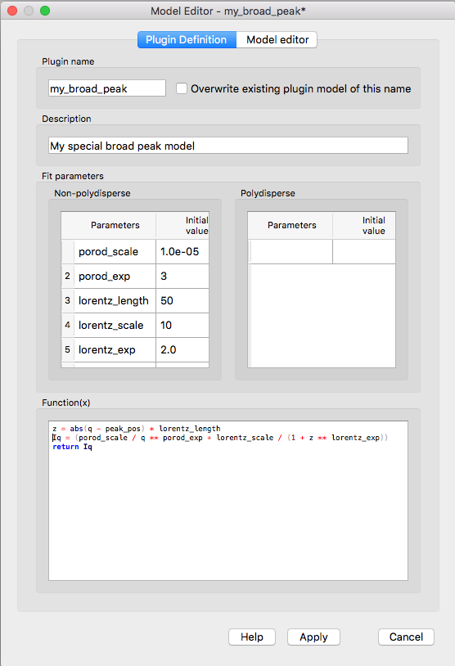
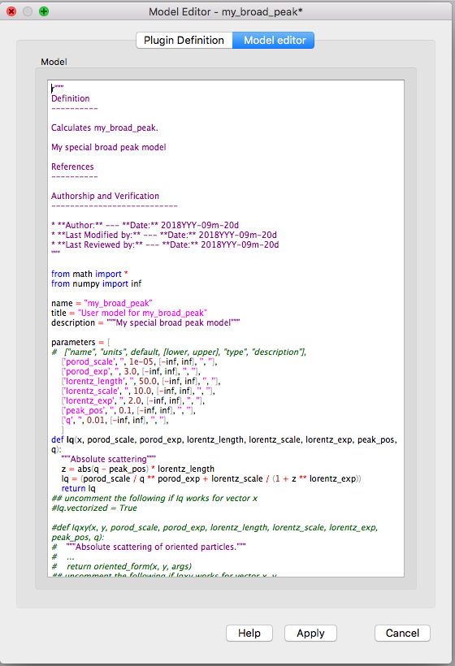
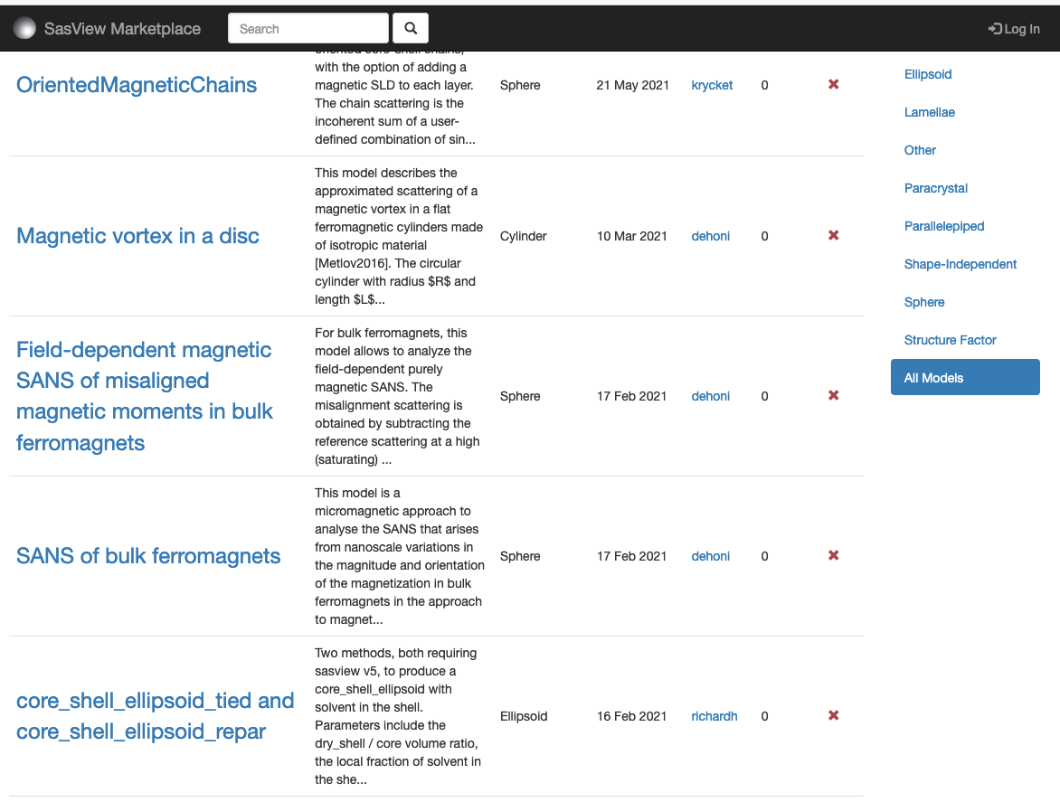
Plugin models
SasView provides tools and infrastructure for custom/plugin models
Dedicated editor
Syntax and performance testing
Directly available in SasView ecosystem
Community developed models can be deposited to marketplace: https://marketplace.sasview.org/

Slide 12
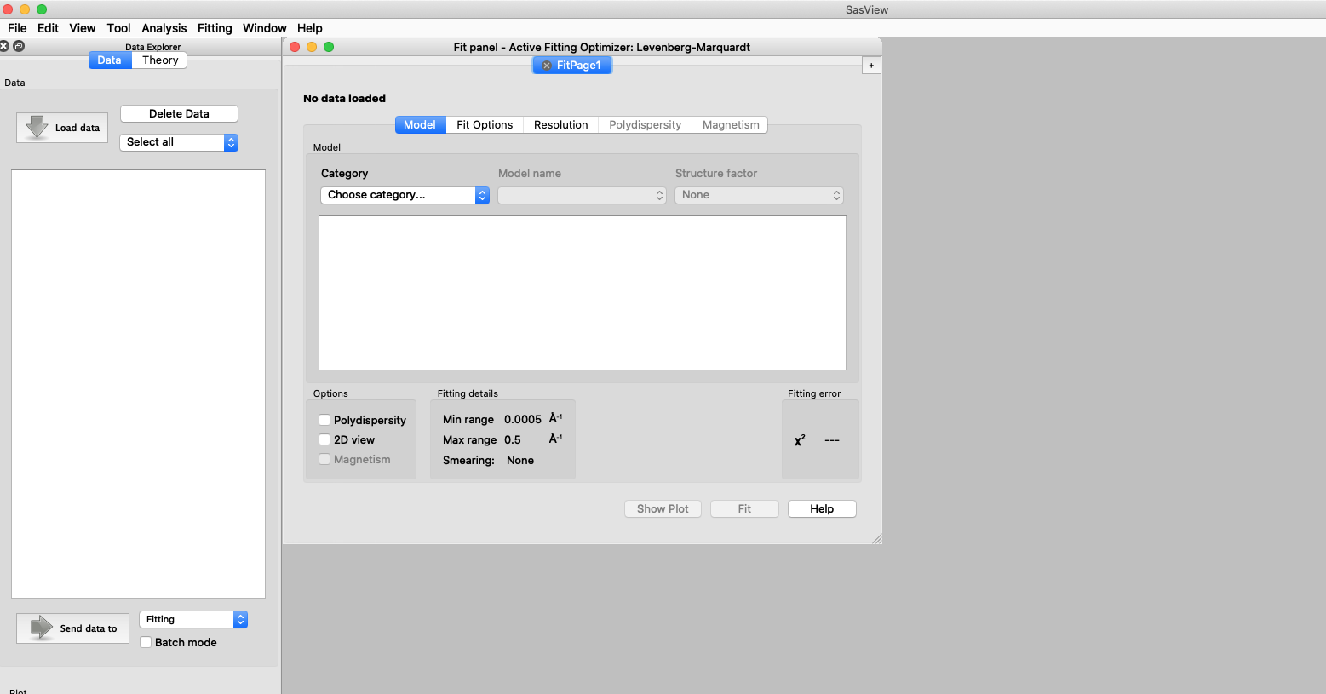
Other SasView functionality
Various utility tools and calculators
Tools
Data Operation
SLD calculator
Density/Volume calculator
Slit Size Calculator
Kiessig Thickness Calculator
Q Resolution Estimator
Generic Scattering calculator
Orientation Viewer
Python Shell/Editor
Image Viewer
File Converter
Analysis
Fitting
Invariant
Pr Inversion
Correlation Function

Slide 13
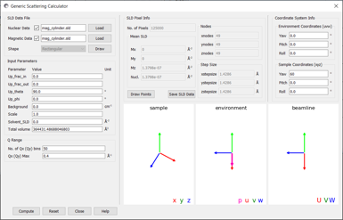
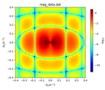
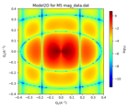
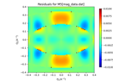
New features
Latest release - SasView 5.0.6
New Features
Generic Scattering Calculator supports magnetic/polarized SANS
Coordinate data in VTK formats supported
The data loaders have been improved (can read multiple <SASData> entries)
Available on conda-forge
New Models on Model Marketplace
Magnetic Whirl, Maier-Saupe distribution, Cyclic Gaussian distribution, Superball Model - Neither Sphere nor Cube, OrientedMagneticChains
https://github.com/SasView/sasview/releases/tag/v5.0.6

Slide 14
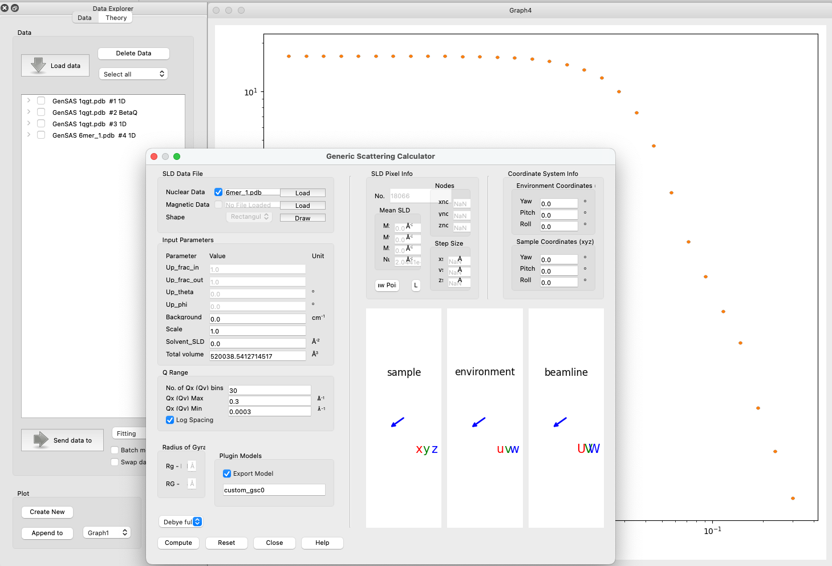
Future developments
Concentrated protein systems
New features in Generic Scattering Calculator:
Calculates form factor from coordinates
Saves as a plugin model
Can be used together with the structure factor
https://github.com/SasView/sasview/releases/tag/nightly-build

Slide 15
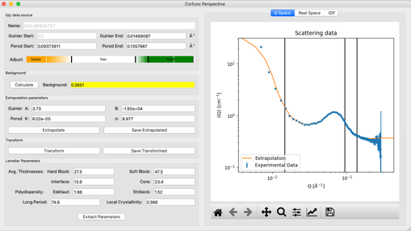
Future developments
SasView 5.0.6 and beyond
Refactoring correlation function
Refactoring P(R) inversion
SAXS/SANS co-refinement
Magnetic workflows upgrades
Improved orientation viewer and slicing
Generic resolution description
Integration with databases and data catalogues
Improved scripting interface
Detailed plans can be found at SasView Road Map
https://github.com/SasView/documents/blob/road_map_update/Sasview%20Roadmap.md

Slide 16
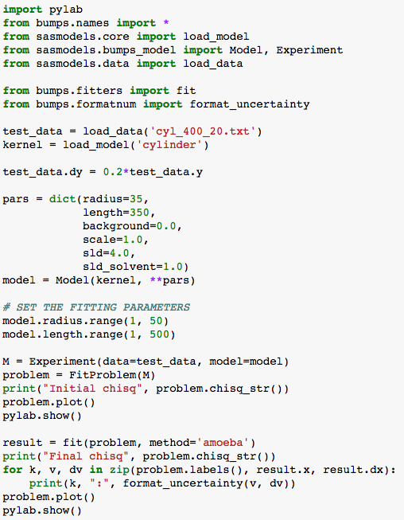
Beyond Graphical User Interface (GUI)
Running SasView from script
Useful for batch jobs and reproducibility
Scripts can be run on computer cluster
Before fit
After fit

Slide 17
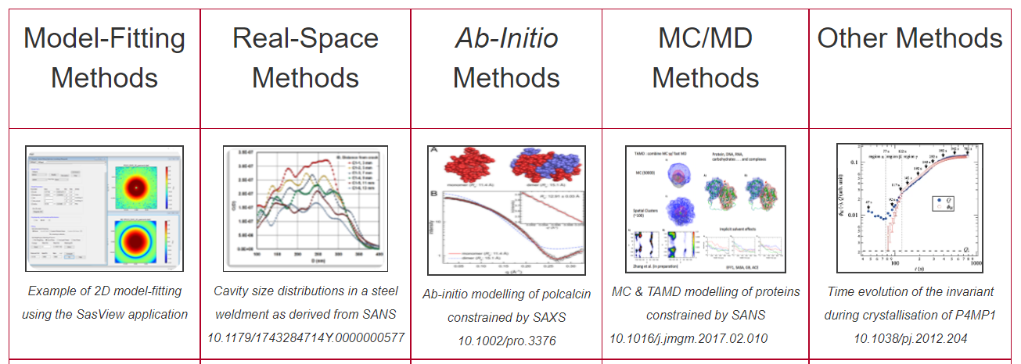
Beyond SasView
Alternative approaches
Not in SasView scope
https://www.isis.stfc.ac.uk/Pages/SANSdataanalysisOverview.aspx

Slide 18
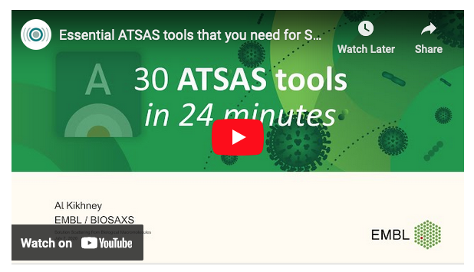
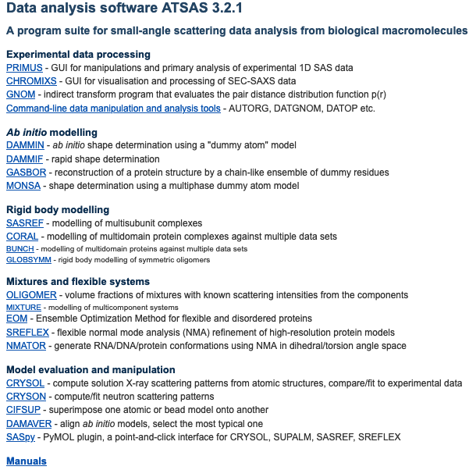
AtSAS
A program suite for SAS data analysis from biological macromolecules
https://www.embl-hamburg.de/biosaxs/software.html

Slide 19
How to contribute
You don’t have to be coding ninja to help out!
Respond to queries posted to help@sasview.org or github
Teach others how to get the best from SasView
Write and improve documentation
Write and record tutorials
Test SasView (over and over!) and write bug reports
Provide new plugin models
Deploy and improve automated testing
Review the code contributions of others
Develop code in Python3/C++ and PyQt/Matplotlib
www.sasview.org/contribute

Slide 20

SAS Clinic
Next round on Oct 20th
Submit your problem
Meet with experts at LINXS
Work together on the problem

Slide 21
Last but not list
Materials available online (linked from the course website)
help@sasview.org for specific questions
Bug reports: https://github.com/SasView/sasview/issues
Feel free to reach out to me directly: wojciech.potrzebowski@ess.eu

Slide 22
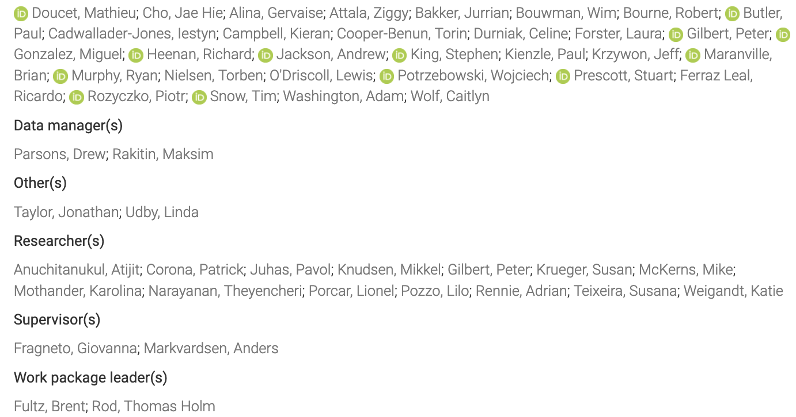
Thank you!
On behalf of SasView community
https://zenodo.org/record/6331344

